Slide 1





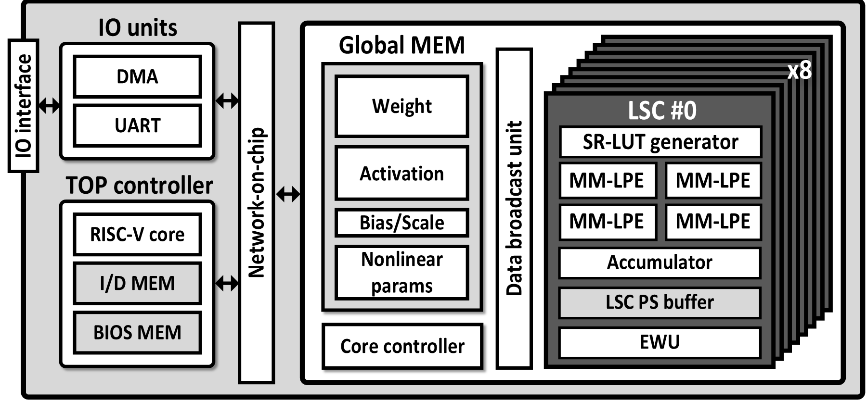
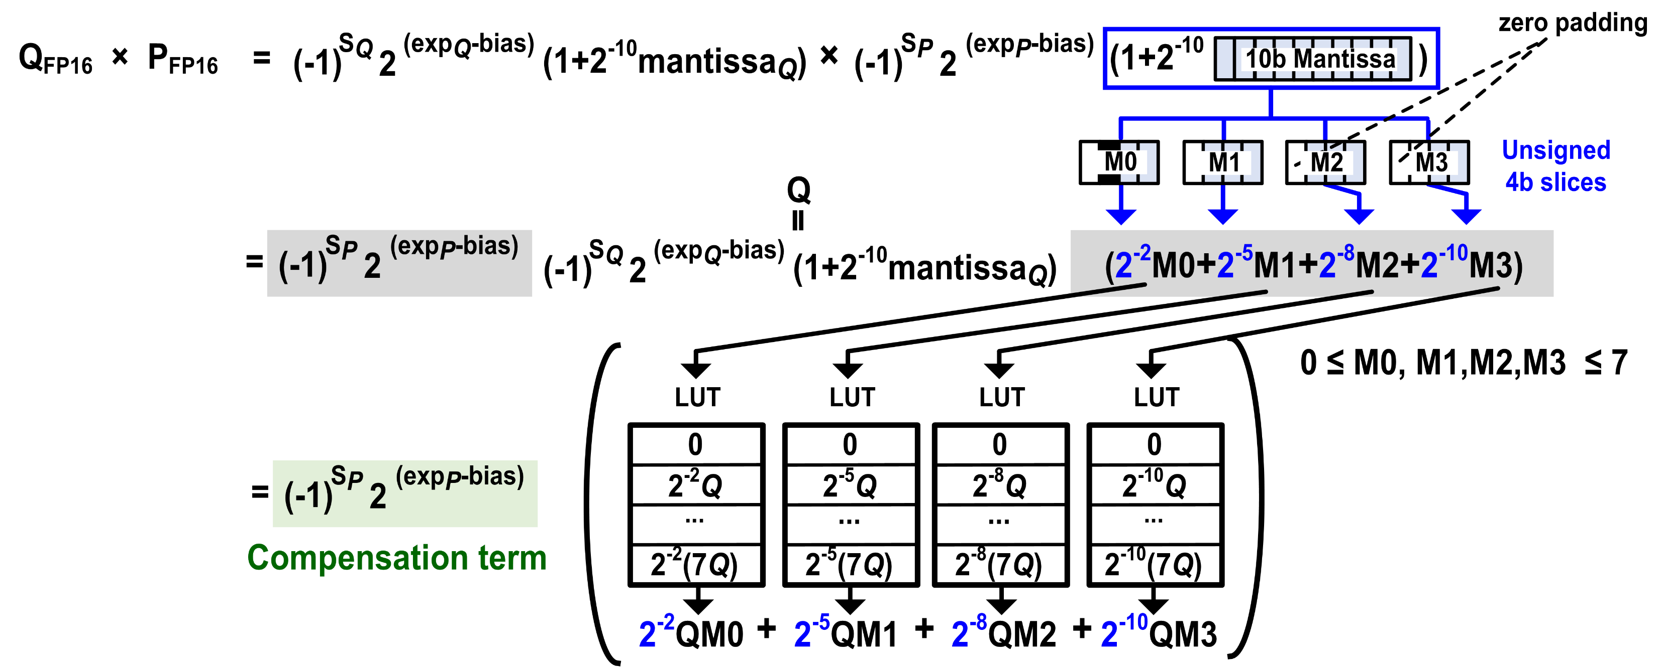
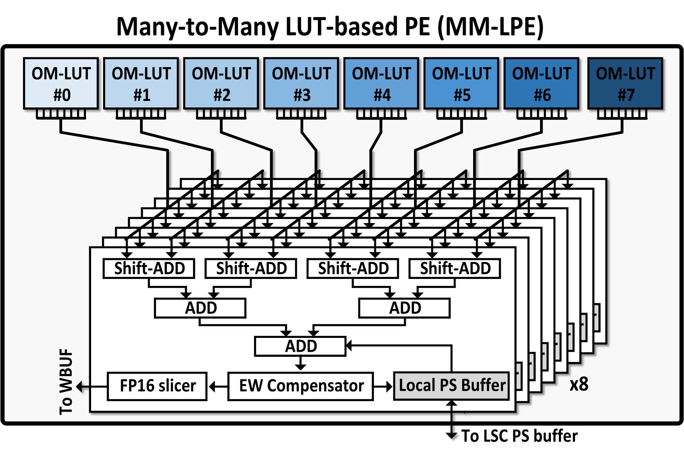
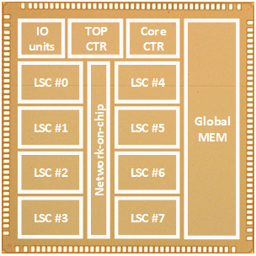
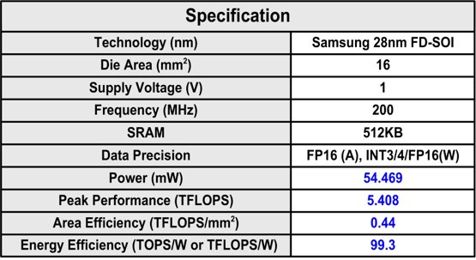
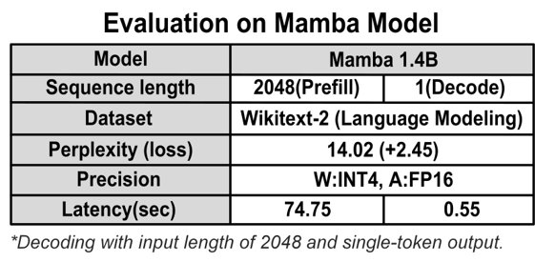
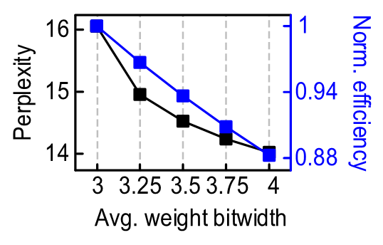
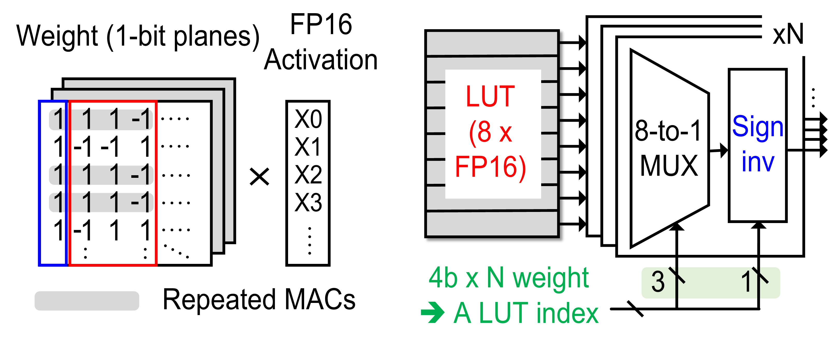
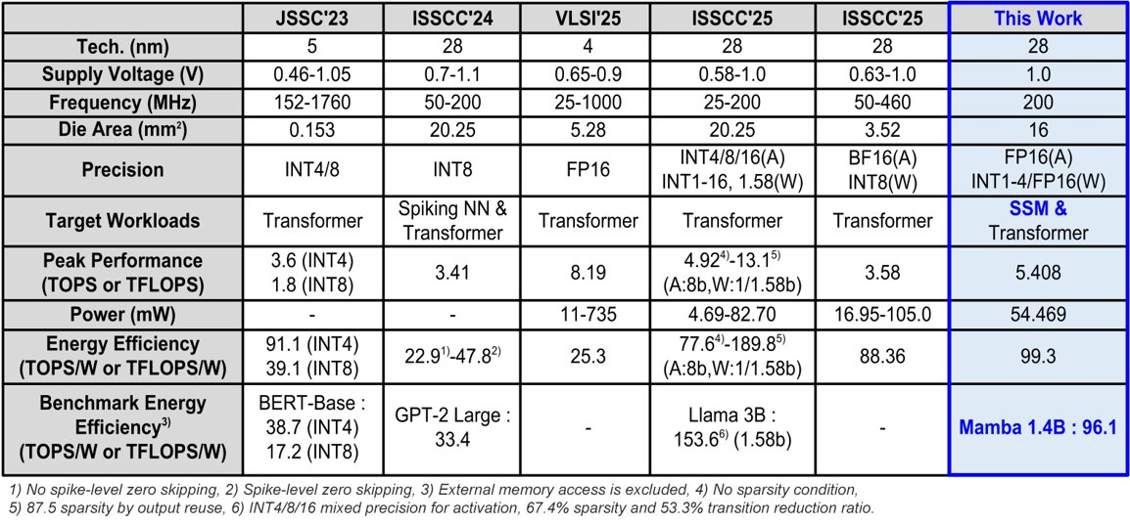
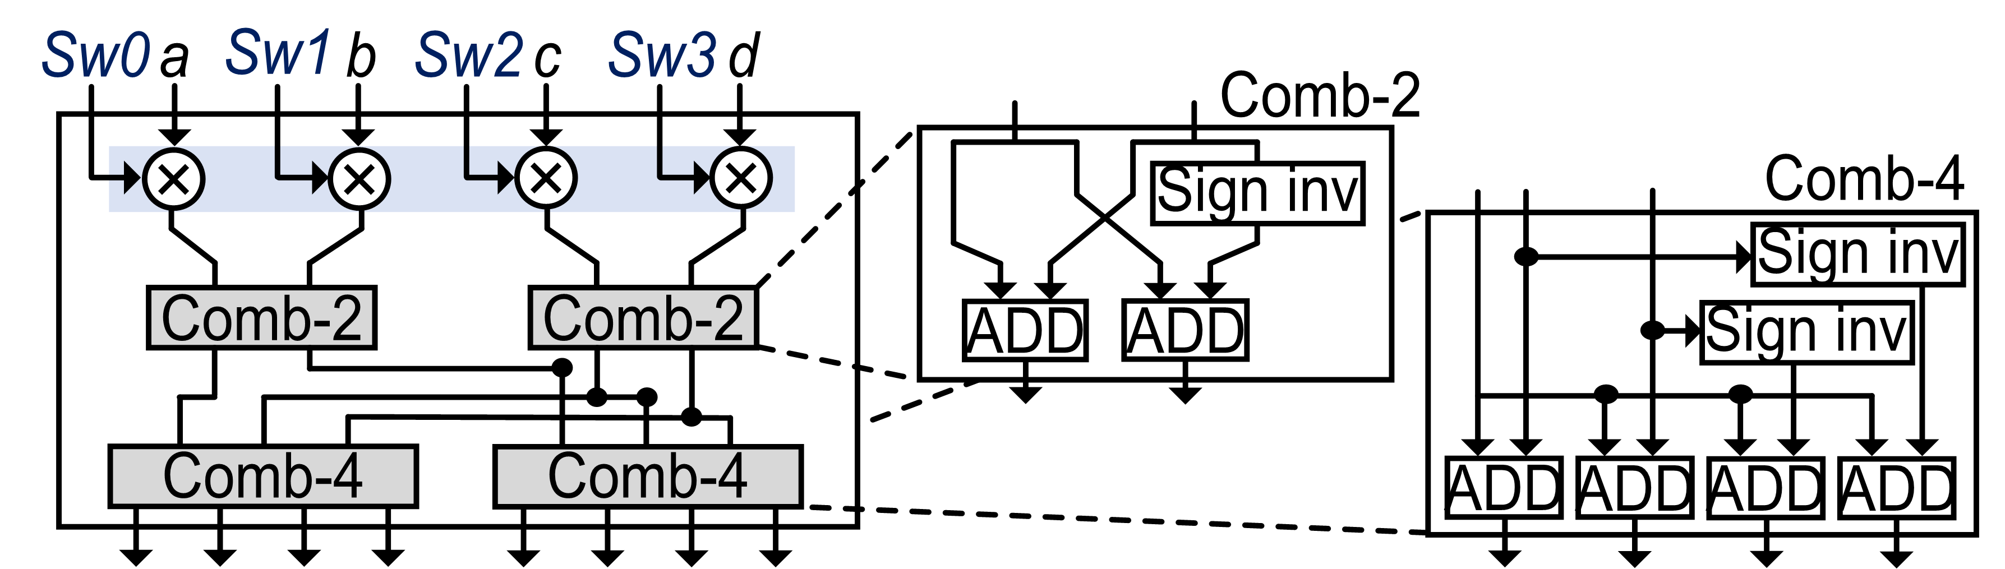
State-Space Model Accelerator Supporting LUT-based Processing and Weight-only quantization
Sunwoo Yoo*^{1,2}, Dongyun Kam*³, Soonhyun Kwon¹ and Youngjoo Lee¹
¹KAIST, ²POSTECH, ³UNIST
Abstract
This work presents LUT-SSM, the first LUT-based accelerator for state-space models (SSMs) such as Mamba. To efficiently support both INT–FP GEMM and sequential FP–FP element-wise (EW) operations under weight-only quantization, we propose three key techniques. First, a many-to-many LUT-based processing element (MM-LPE) enables spatial LUT reuse across multiple accumulators, eliminating redundant LUT writes. Second, a LUT-based EW layer fusion scheme maps FP–FP multiplications onto the MM-LPE via FP slicing. Third, a scale-reflected LUT (SR-LUT) generator natively supports column-wise group quantization by absorbing scale multiplications into LUT generation. Fabricated in 28nm FD-SOI, LUT-SSM demonstrates significant energy savings and latency improvements over existing architectures.
Proposed Design
FP-FP elementwise operation in LUT-based PE
Overall architecture
The accelerator integrates eight LUT-based SSM cores, a RISC-V controller, and a shared global memory over a network-on-chip.
Each FP operand is sliced into 4-bit segments and mapped onto the MM-LPE, while the compensation term resolves the exponent and sign with an adder and XOR.
Proposed LUT-based PE (MM-LPE)
Implementation Results
Measurement results
Multiple LUTs are spatially shared across multiple accumulators, so each LUT output is reused by several accumulators and redundant LUT writes are eliminated.
One-to-Many LUT compute engine (OM-LUT)
Comparison to other state-of-the-art accelerators
Scale-Reflected LUT generator

